Slide 1

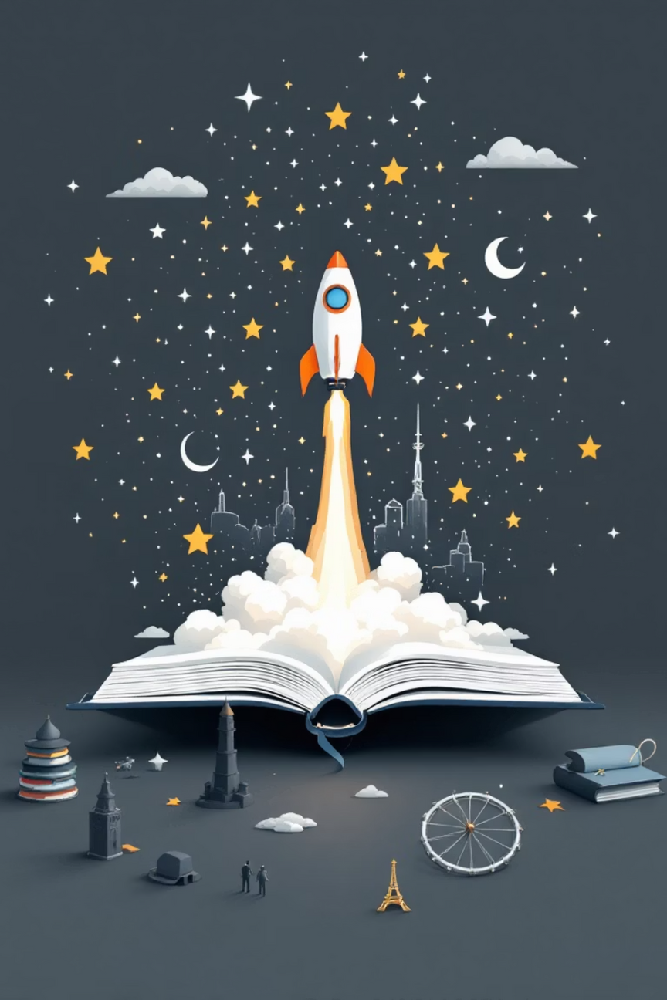
Language Adventure:
From Words to European Stars
1
Learn fun facts about Europe
2
Discover untranslatable words
3
Meet famous European stars
4
Reflect on learning
Notes:
1

Slide 2
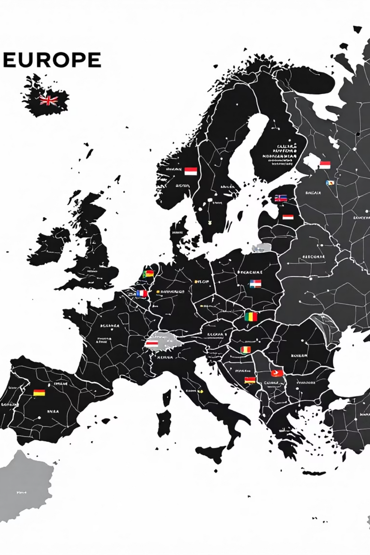
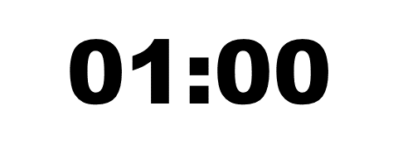

Quick Challenge
You have a minute to write down as many European languages as you can.
Notes:
2

Slide 3
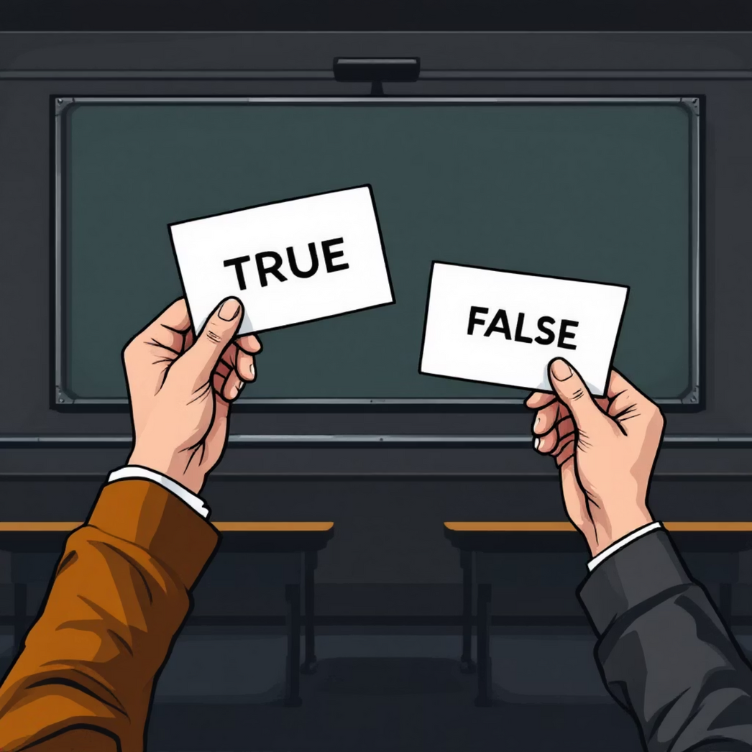
In groups: discuss & show your answer card (TRUE or FALSE)
Fact Race
Notes:
3

Slide 4
01
Fact Race
Europe is the smallest continent in the world.
02
03
More than 200 languages are spoken in Europe.
Germany has the largest population in Europe.
04
Germany has the most castles in Europe – over 25,000.
05
The Louvre in Paris is the most visited museum in Europe.
Notes:
4

Slide 5

Language Treasures (Matching Game)
Match the word with the correct definition!
Hygge
Mangata
Lagom
Tartle
Prozvonit
Fernweh
Saudade
Notes:
5

Slide 6
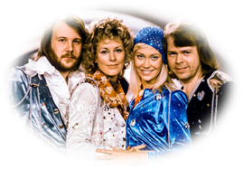
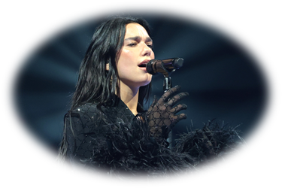
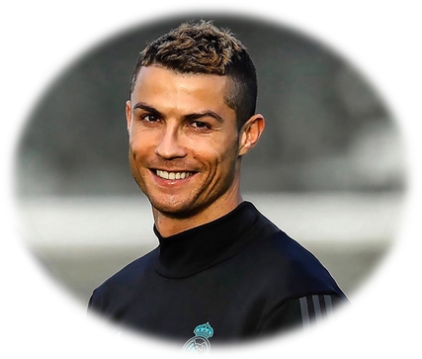
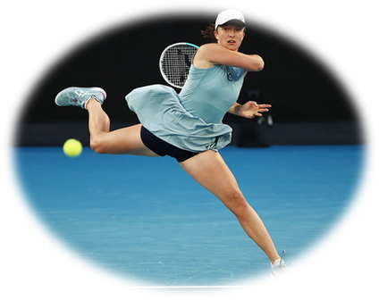
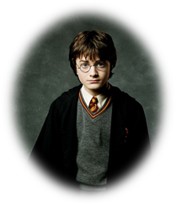
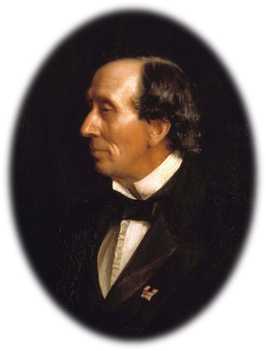
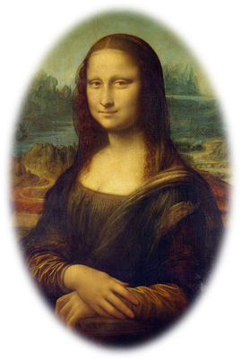
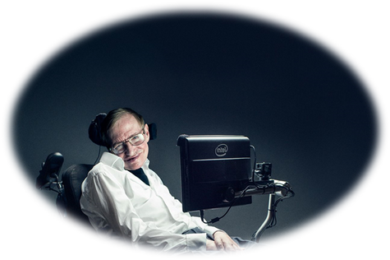
European Stars Quiz
ABBA
Dua Lipa
Cristiano Ronaldo
Iga Świątek
Which country is the group ABBA from?
Where is the pop singer Dua Lipa
originally from?
Which country is Cristiano Ronaldo from?
Which country does tennis star Iga Świątek
represent?
Harry Potter
Hans Christian Andersen
Mona Liza
Stephen Hawking
Which country was Hans Christian
Andersen from?
Who painted the Mona Lisa?
Which country was scientist
Stephen Hawking from?
Who wrote the Harry Potter books?
Notes:
6

Slide 7
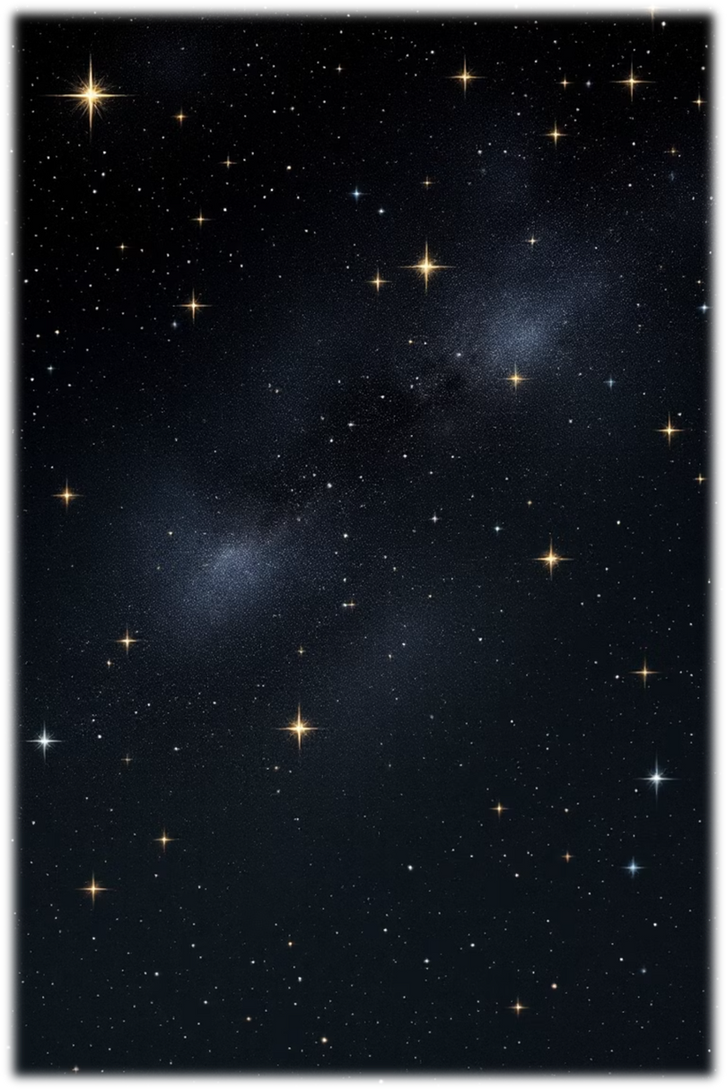

Wrap-up & Reflection – From Words to Stars
Think of one word in any European language that best describes how you feel after today’s lesson.
What did you like most today?
What new word or fact did you learn?
Which part surprised you?
Notes:
7

