Slide 1
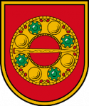
THE REFLECTIONS OF COMENIUS PROJECT IN PRIVATE OZCAN PRIMARY SCHOOL
MAY , 2013

Slide 2
OUTLINE
Comenius Project-Language of Art for Ozcan Primary School
The importance of Project for us
The reason of being a partner for us
The effects of mobilities and activities
The opportunities provided by mobilities and activities
The approach of our students and teachers to the project
The benefits of the Project for our teachers and students
The changes of our students’ and teachers’ perspectives
The other projects having been attended by our school
The importance of the projects based on cultural interaction and communication
Conclusion

Slide 3
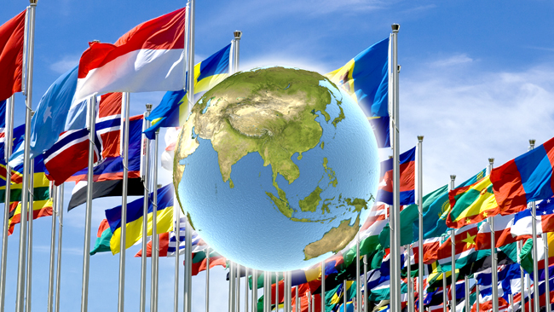
What is Comenius Project –Language of Art for us ?
It as an opportunity to wide international relations that should be done in such a global world to be able to aware of different points of various cultures , nations and societies .

Slide 4
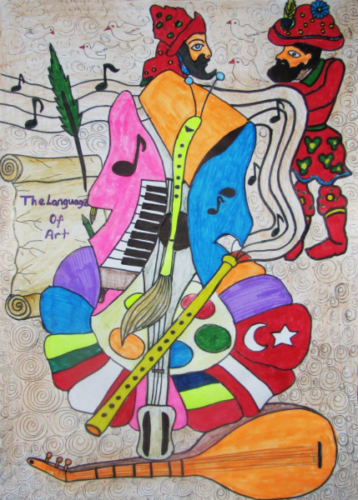
What is Comenius Project –Language of Art for us ?
A way of friendship and interaction constructed on sincerity coming from the beauties of cultures and art

Slide 5
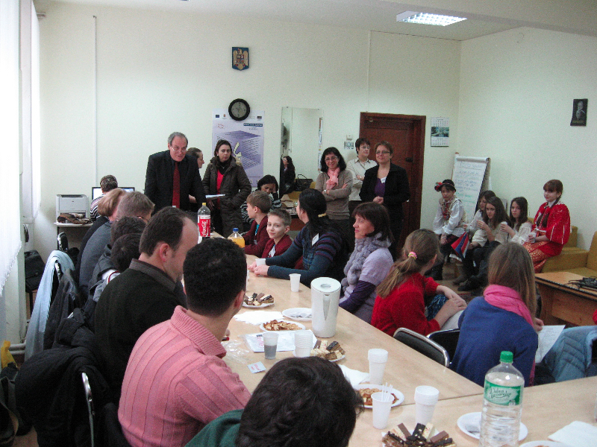
What is the importance of this Project for us ?
We have already known our own cultures , education systems and different sides of our own countries in general.
But what about the knowledge about each other ? Is it enough to know just yourself ?

Slide 6
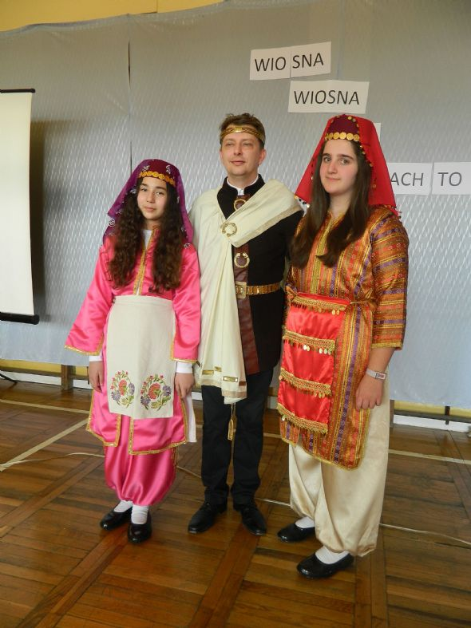
What is the importance of this Project for us ?
The project is an opportunity to discover ourselves , as Turkey .

Slide 7
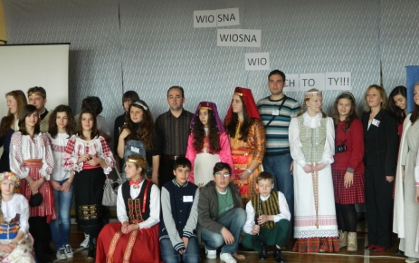
Why did we want to be a part of this Project circle ?
To make you know our culture
and education system

Slide 8
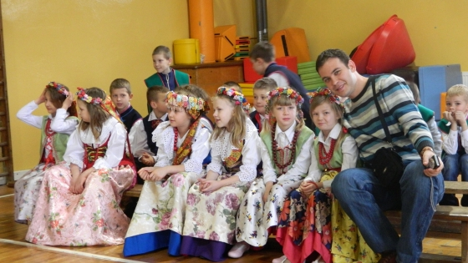
Why did we want to be a part of this Project circle ?
To learn new cultures and develop international relations

Slide 9
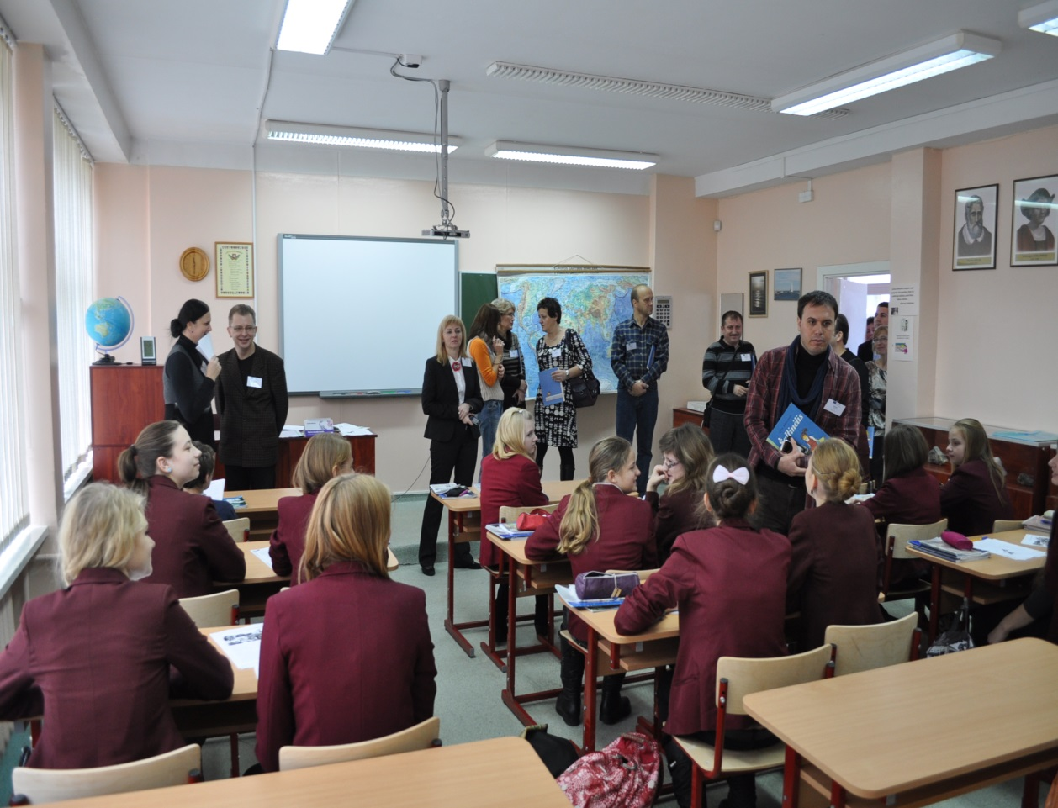
Why did we want to be a part of this Project circle ?
To be able to make comparisons and assess ourselves in terms of some important points relating to education , teaching / learning process of different subjects

Slide 10
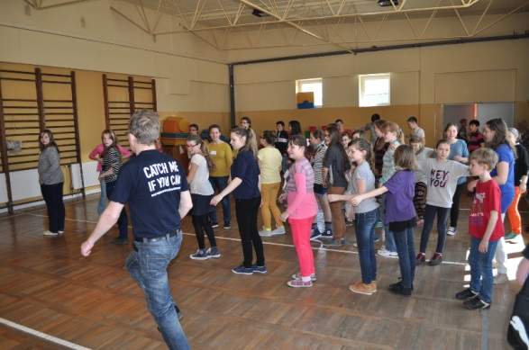
What are the reasons of the mobilities and activities done during the Project according to us ?
These visits maintain learning various cultural facts effectively , with workshops , activities , presentations or accommodations , house holdings and every minutes wasted during the visits.

Slide 11
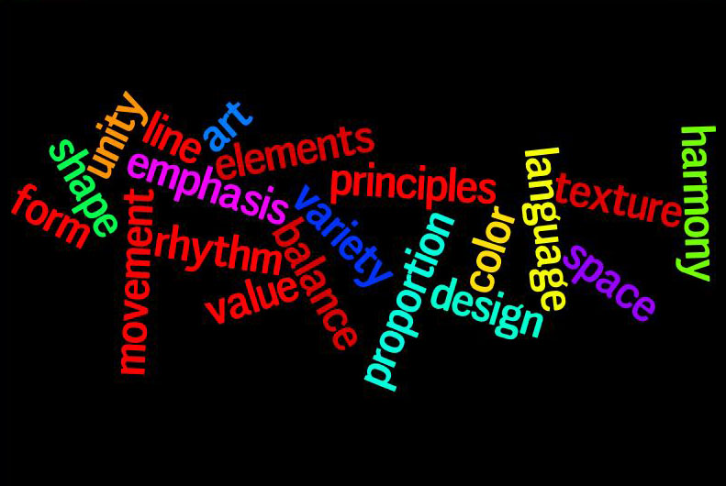
What are the opportunities provided by these mobilities and activities?
Every country has tried to reflect the soul of their culture in the best way .

Slide 12
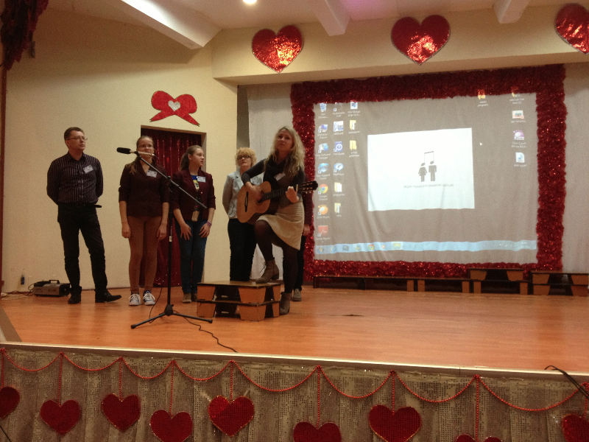
What are the opportunities provided by these mobilities and activities?
A source for us to get the cultural sides of different countries exactly, including traditional sides ( clothes , songs, stories , fairytales) , cuisines , customs , habits , daily life and with workshops and lessons new and different techniques and methods that can be applied in our education system

Slide 13
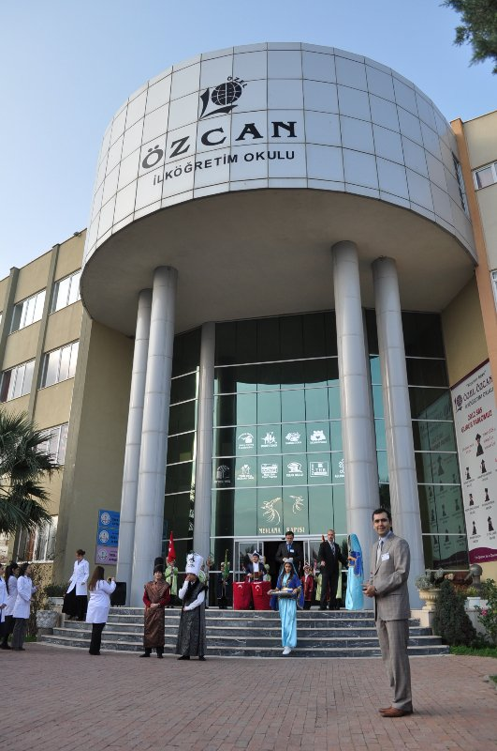
How do our teachers and students approach to the Project activities?
Our teachers and students handle this Project to know and learn other countries’ cultural and educational sides to wide their range of knowledge about the differences between nations .

Slide 14
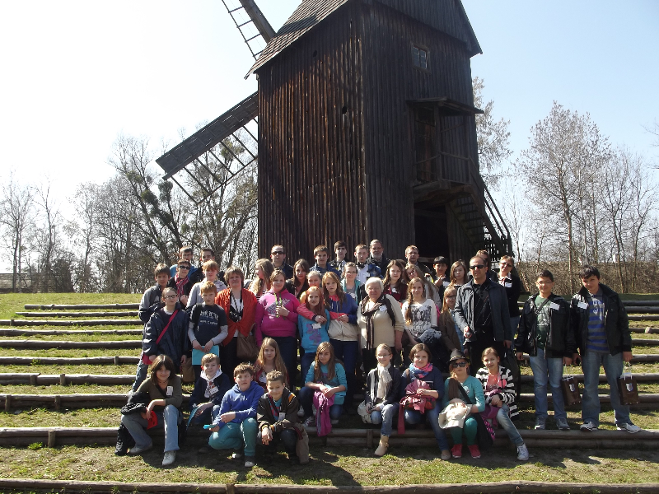
How do our teachers and students approach to the Project activities?
They have made what they can do during this process to achieve learning and making other partners know us better.

Slide 15
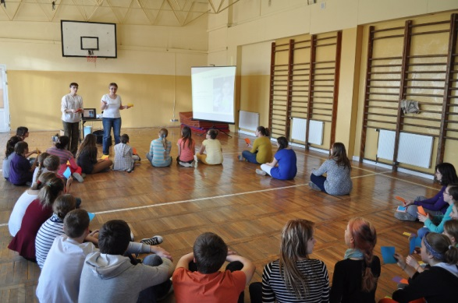
How did our teachers and students benefit from the Project ?
This can not be ignored that for teachers and students the most important parts of this Project is workshop activities.

Slide 16
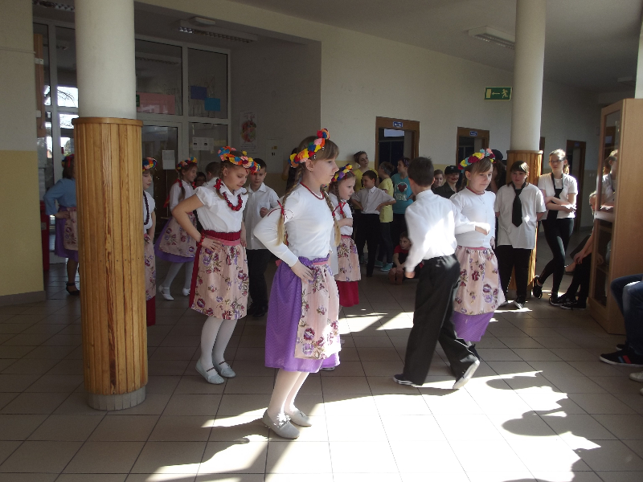
How did our teachers and students benefit from the Project ?
With workshops , we have seen countless facts coming from cultural points which are important to know each other successfully .

Slide 17
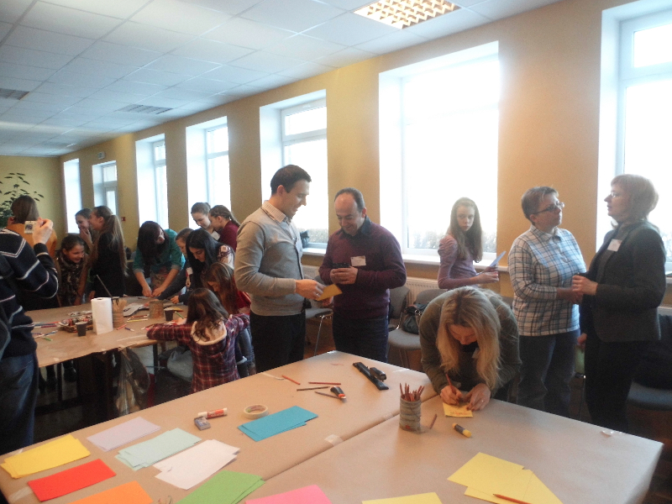
How did our teachers and students benefit from the Project ?
We should say that we , as Turkish teachers learn many techniques to be able to apply during our own lessons in Art, Literature ,English and many others.

Slide 18
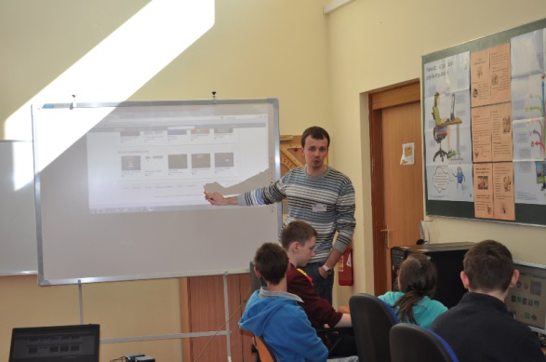
How did our teachers and students benefit from the Project ?
Our teachers’ observations during the mobilities and activities are shared with our other teachers in school. So , these sharings reach a lot of different people and a lot of people learn new styles of techniques and methods.

Slide 19
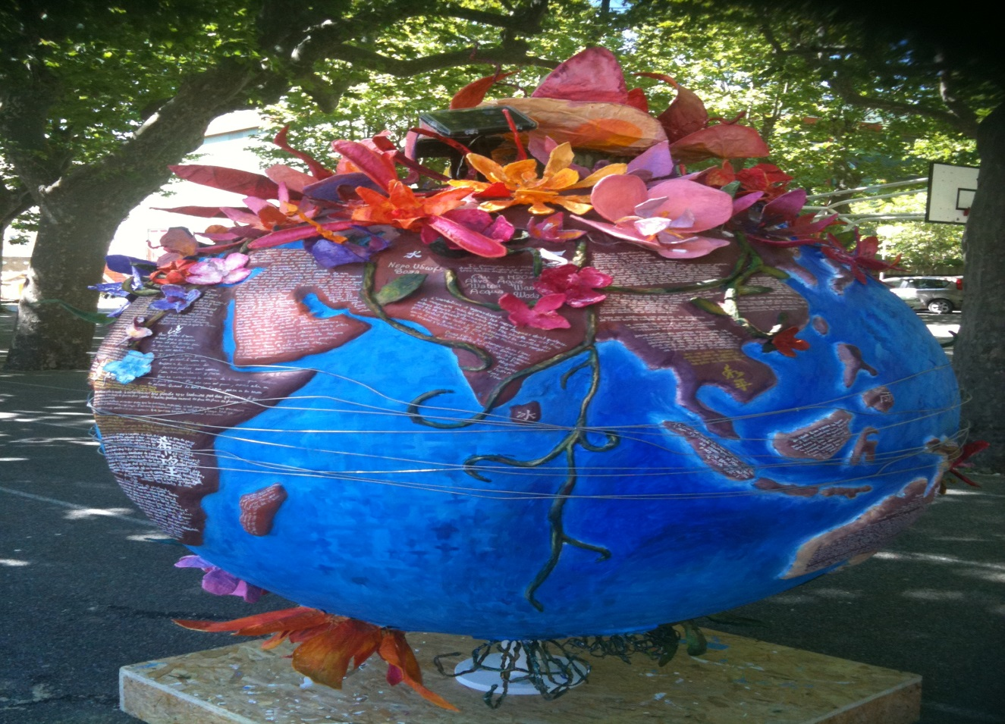
Did the mobilities and activities make any change in the perspective of our teachers and students in terms of global view ?
If we live in a global World , we should look at the World from a global window.

Slide 20
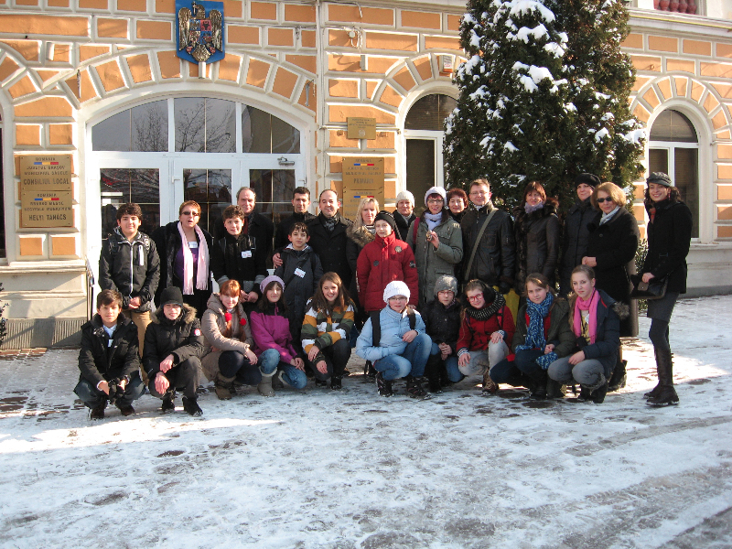
Did the mobilities and activities make any change in the perspective of our teachers and students in terms of global view ?
We have new friendships and international relations based on sincerity and tolerance.

Slide 21
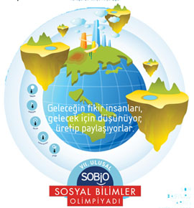
What are the other projects that our school have attended ?

Slide 22
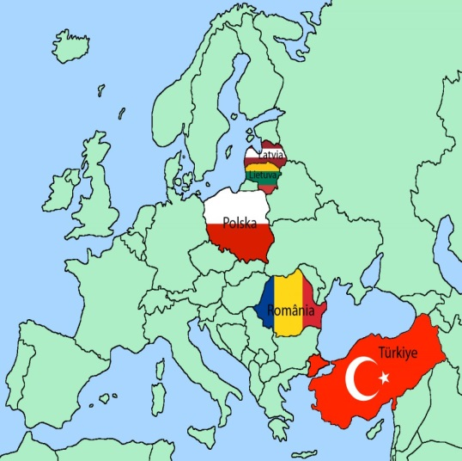
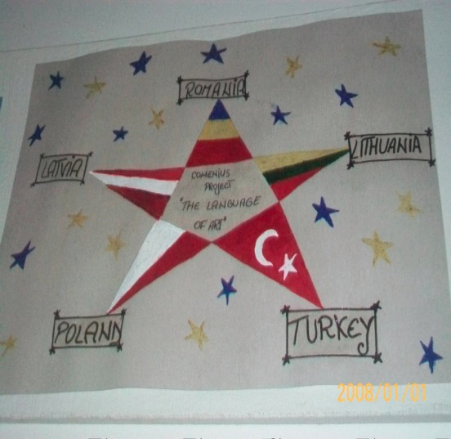
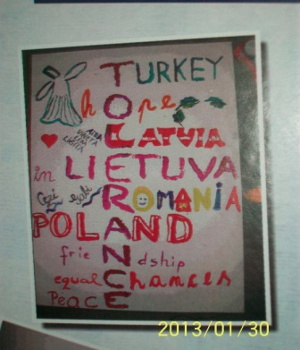
Why are the projects like Comenius Project –Language of Art based on cultural interaction and communication valuable ?
Projects based on cultural interaction and communication are valuable and people need such projects to kill two birds with one stone. We can say we reach this goal successfully .

Slide 23
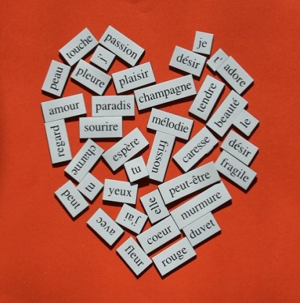
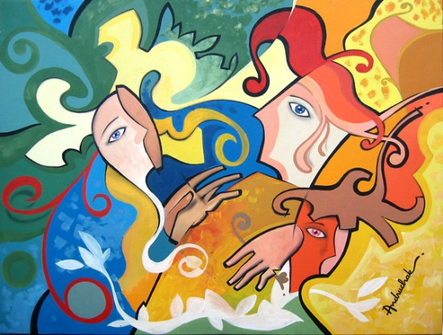
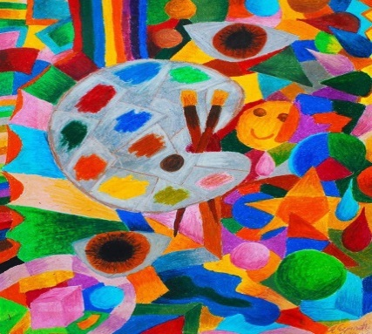
Why are the projects like Comenius Project –Language of Art based on cultural interaction and communication valuable ?
During the process we shared , the things we learn about each other are countless. We find chances to learn our cultures , customs , traditions , cuisines and many other sides.
We achieve this by using educational sharings relating to Art , Literature ,Music and other schools by using English as common language . In addition , we , now , have new international friendships that are unforgettable for us .

Slide 24
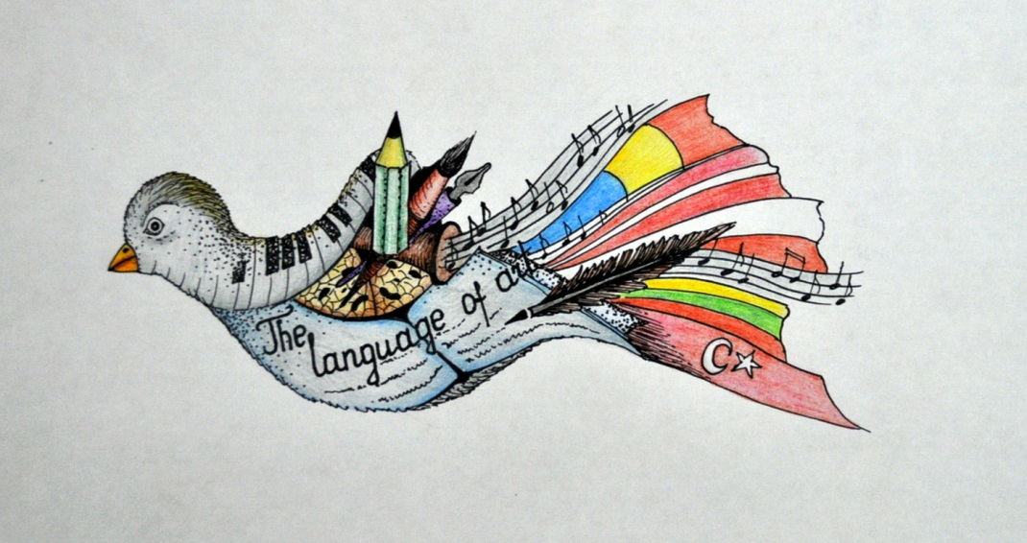
Conclusion
Not to kill two birds with a stone , but to kill many birds with a stone !

Slide 25
Thanks for your listening …

